Slide 1
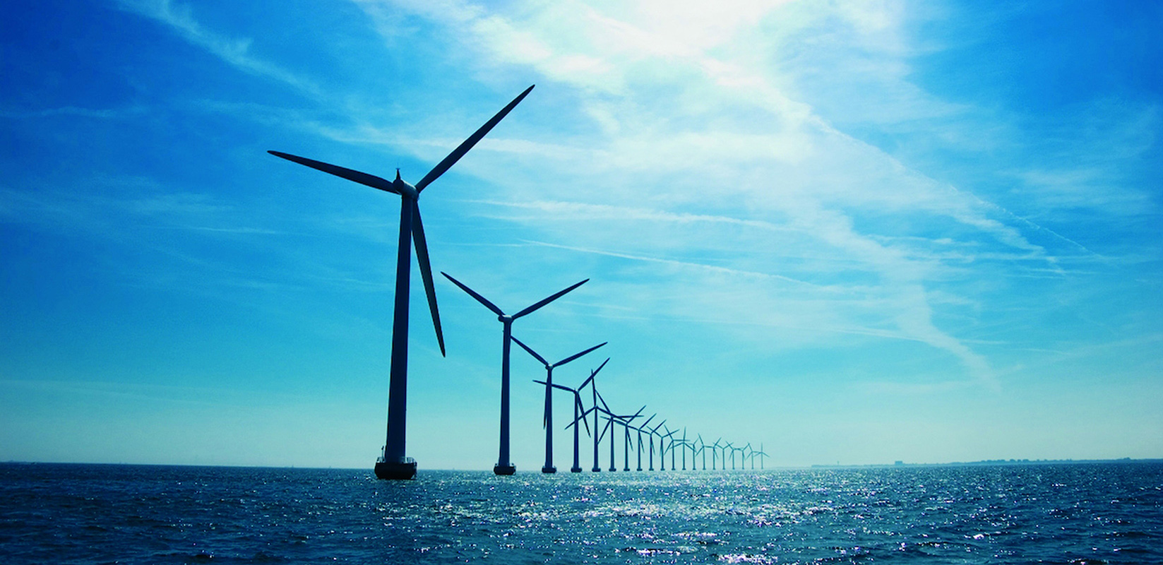
Virginia is all in for Offshore Wind
Jennifer K. Palestrant
Chief Deputy, DMME
jennifer.palestrant@dmme.virginia.gov
42

Slide 2
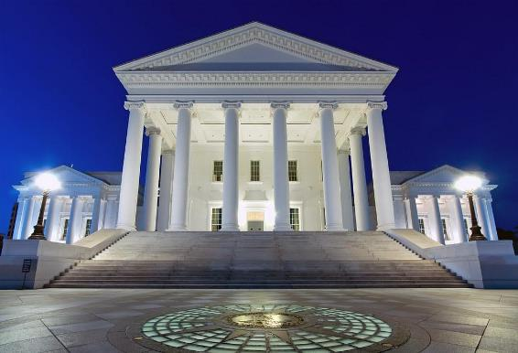
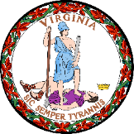
2020 Virginia Clean Economy Act
A mandatory renewable portfolio standard (RPS):
40% by 2030; 100% by 2045
A mandatory energy efficiency resource standard (EERS):
5% by 2025
Deems 16,100 MW of solar and onshore wind, 5,200 MW of offshore wind, and 2,700 MW of energy storage in the public interest.
Clean Energy
Virginia

Slide 3
Virginia Offshore Wind Timeline and Milestones
September ‘19
Governor Northam signs EO43: 30% renewable electricity by 2030 & 100% by 2050
BOEM fully permits CVOW: only permitted project in federal waters
Dominion announces largest project in NA
2015
BOEM issues first research lease to DMME (site of CVOW)
DMME releases Port Readiness Study
2009
BOEM and VA convene Renewable Energy Task to identify OSW lease areas
2018
Governor Northam signs legislation authorizing CVOW construction
April ‘20
Governor Northam signs VCEA and OSW legislation: 5200MW by 2034
2011
Governor McDonnell announces that Virginia will bid for an offshore lease site BOEM
July ‘19
Onshore construction of CVOW begins
January ‘20
Orsted signs lease at PMT for up to 40 acres
Siemens Gamesa will partner to provide the turbines for VCWEA
June ‘20
CVOW turbines installed – 1st in federal waters
2010
Virginia creates the Virginia Offshore Wind Development Authority (VOWDA)
2013
Dominion wins auction for VCWEA
2017
Coastal Virginia Offshore Wind (CVOW) project announced
Clean Energy
Virginia

Slide 4
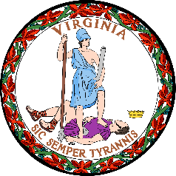
Coastal Virginia Offshore Wind (CVOW)
Pilot & Commercial
Commercial Lease Areas: Virginia and North Carolina
Kitty Hawk
Clean Energy
Virginia
Notes:
Slide to be updated for consistency across 5 webinars

Slide 5
HAMPTON ROADS HARBOR

Slide 6
Advantage: Virginia
Post-Panamax: Deepening to 55’
18 miles from open sea with no overhead obstructions
Central location
Stellar workforce
Strong terminal infrastructure and robust intermodal connections
Largest marine industrial center in the country

Slide 7
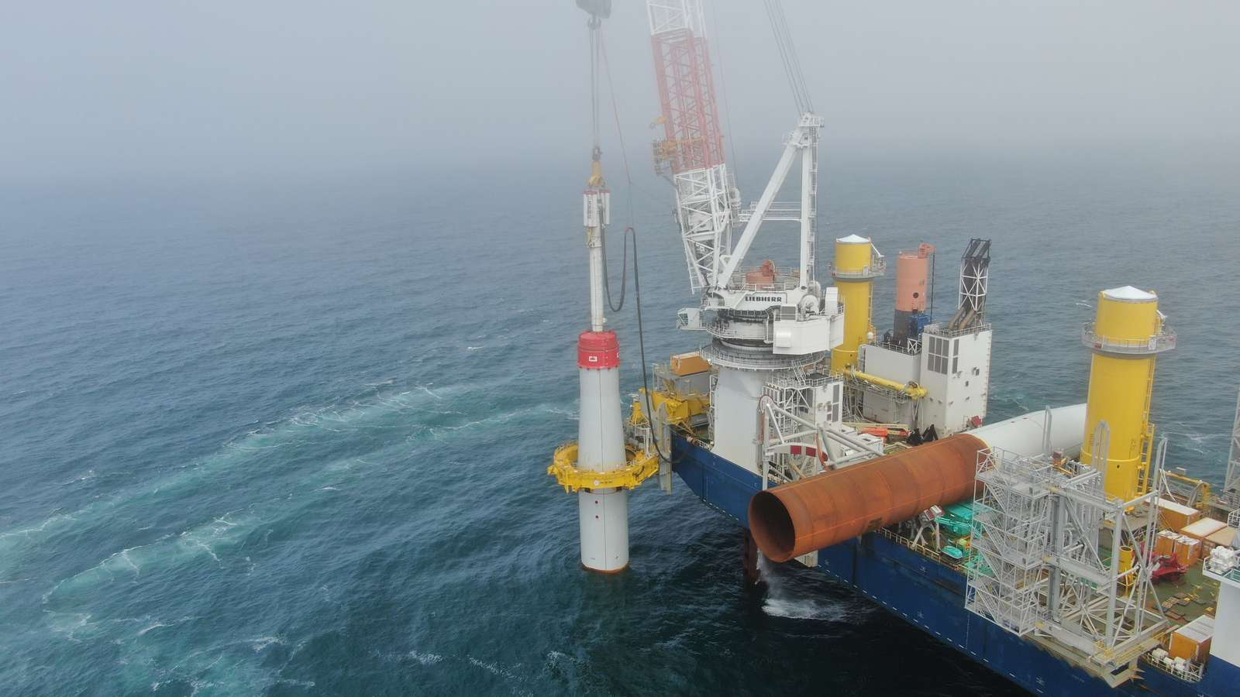
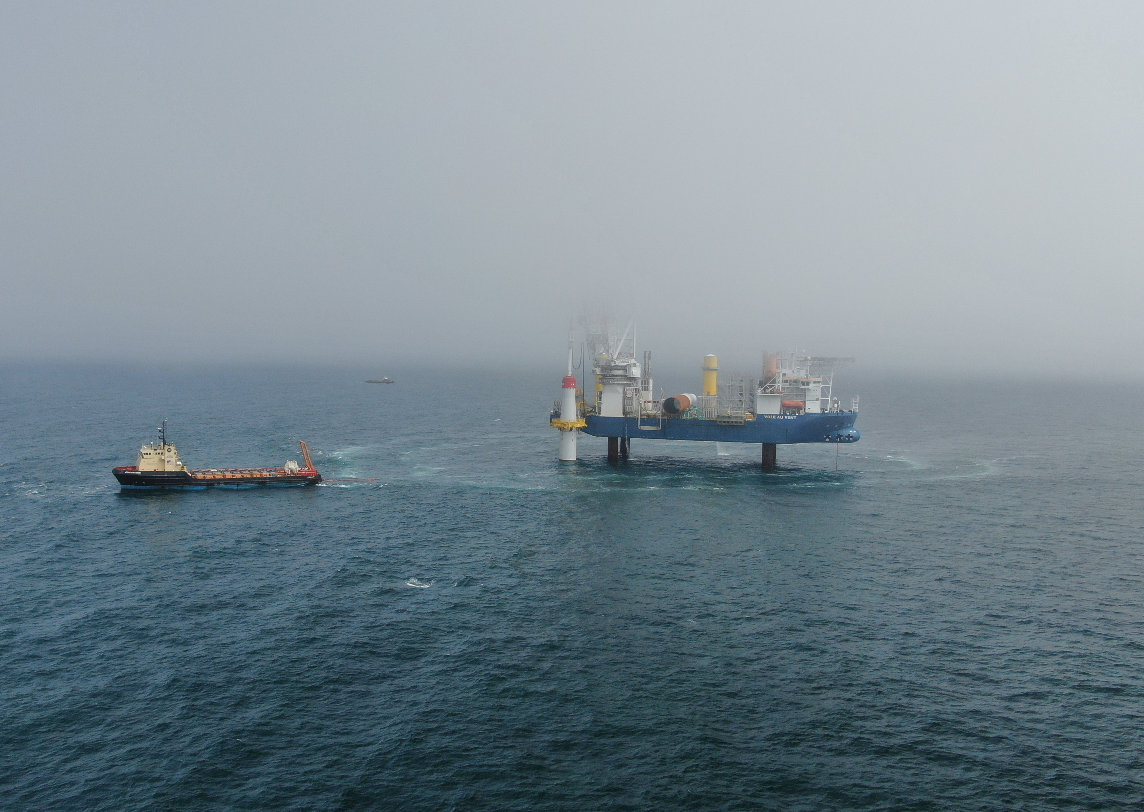
Coastal Virginia Offshore Wind (CVOW) Pilot Foundation Installation
First steel in the water – Memorial Day

Slide 8
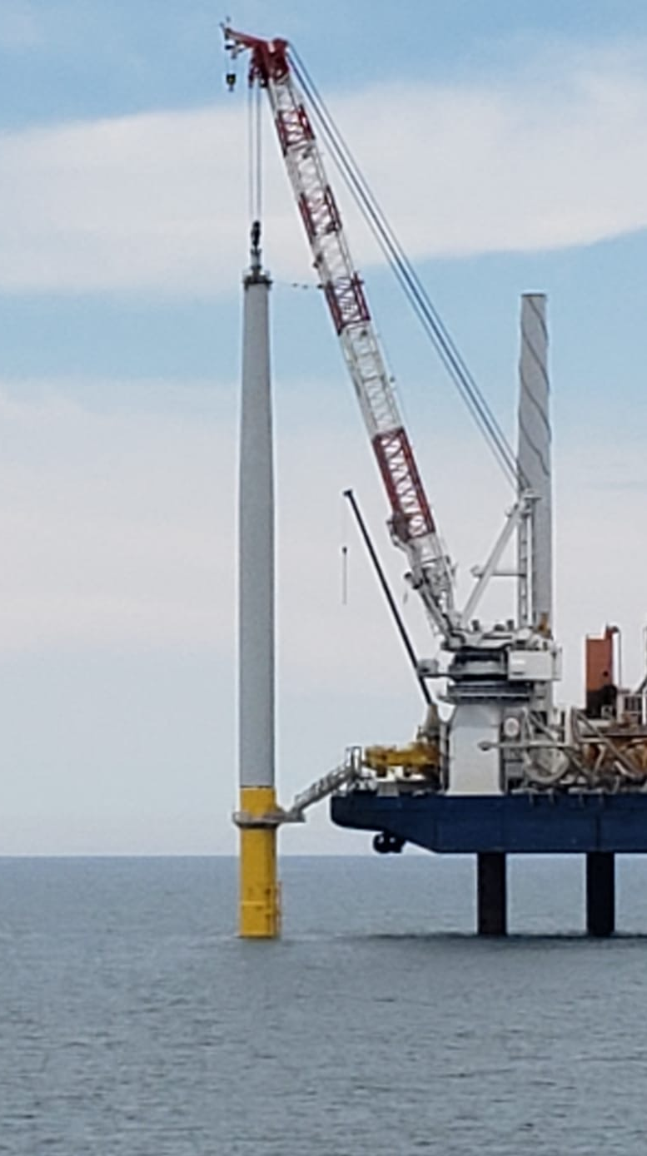
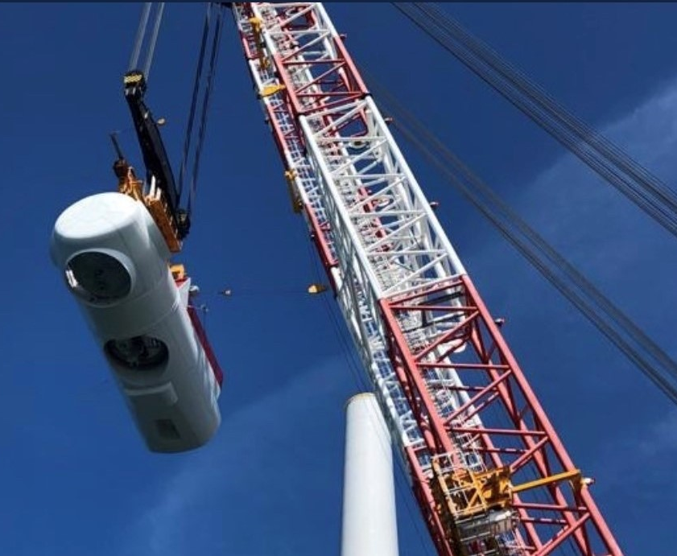
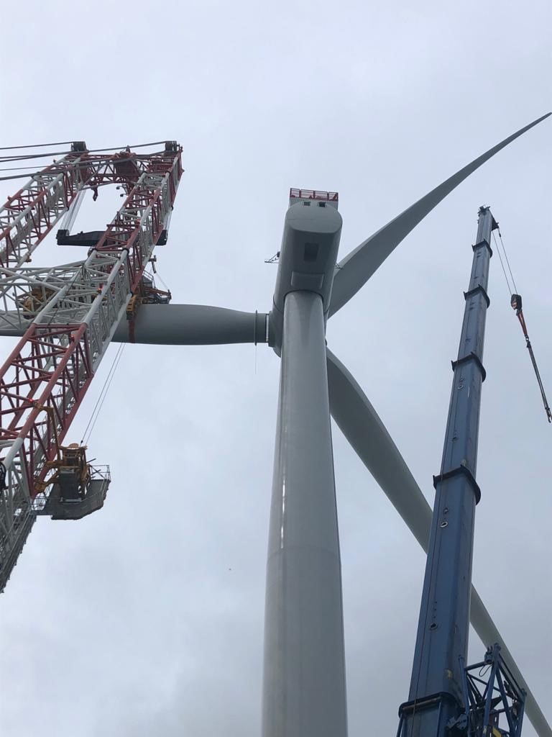
Coastal Virginia Offshore Wind (CVOW) Pilot Wind Turbine Installation
Tower, Nacelle and Blade Installation

Slide 9
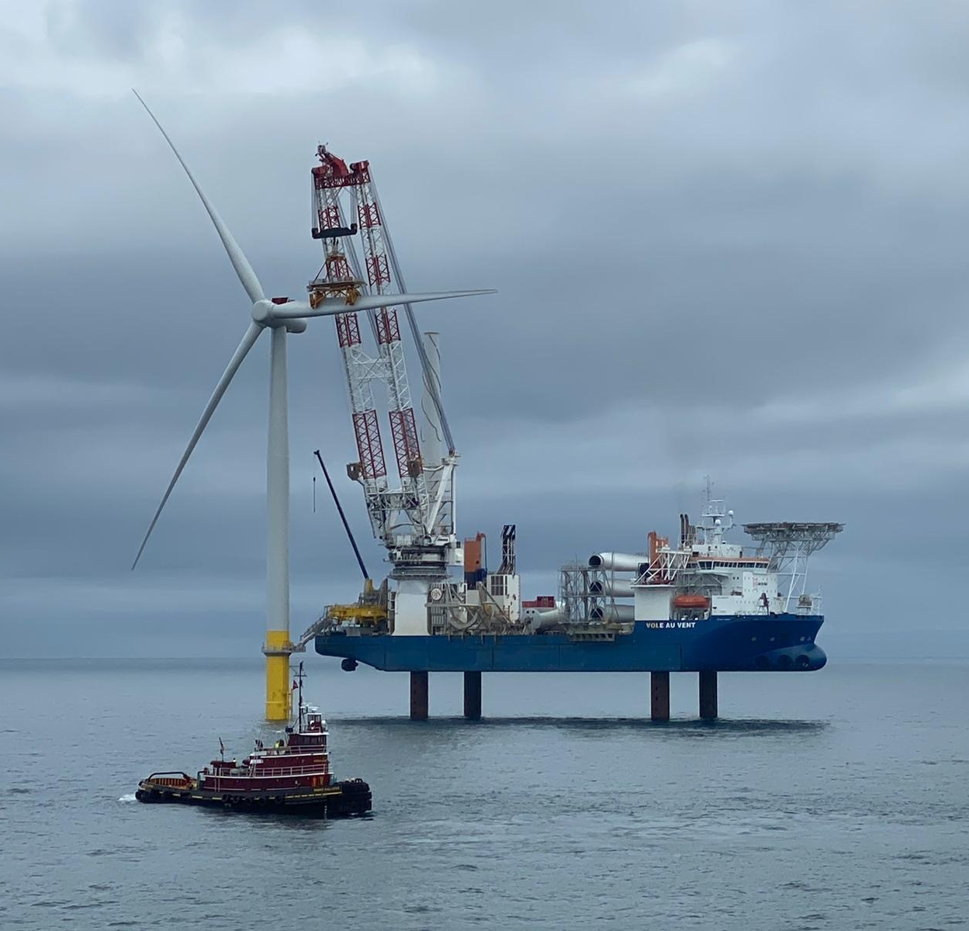
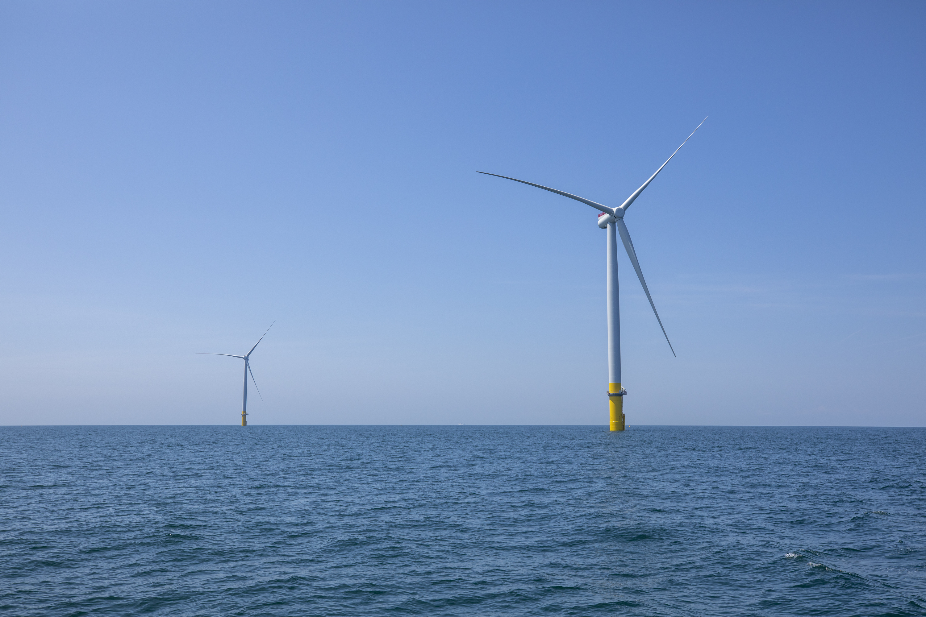
Coastal Virginia Offshore Wind (CVOW) Pilot First Turbines Installed in Federal Waters
First wind turbine mechanically complete – June 20th
Second wind turbine mechanically complete – June 26th

Slide 10
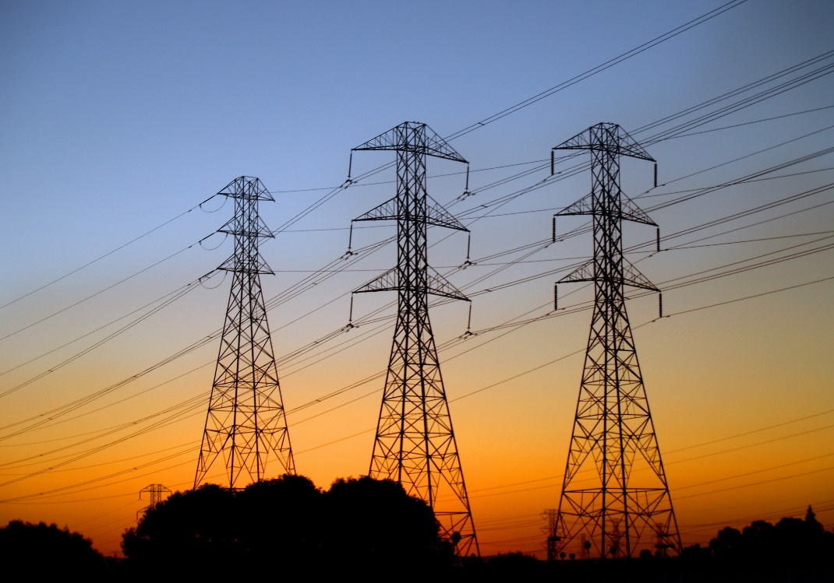
Transmission
The interconnection requests have been submitted to PJM for both the Kitty Hawk and Dominion projects.
The power for Kitty Hawk will come ashore in Virginia Beach due to the low population density in northeastern North Carolina.
Being home to 90 federal facilities including the east coast master jet base and the largest navy base in the world, we have plenty of power to go around.
As always, the challenge is where are the choke points for the power as it travels from the coast to Richmond, DC and onward.
Clean Energy
Virginia

