Slide 1
North Carolina’s OSW Plans
Presentation to Offshore Wind Transmission, U.S.
4th edition | virtual conference | September 23, 2020
Dr. John Hardin, executive Director | jhardin@nccommerce.com
Office of Science, Technology & Innovation (OSTI)
North Carolina Department of Commerce
www.nccommerce.com/business/key-industries-north-carolina/energy/offshore-wind-industry

Slide 2
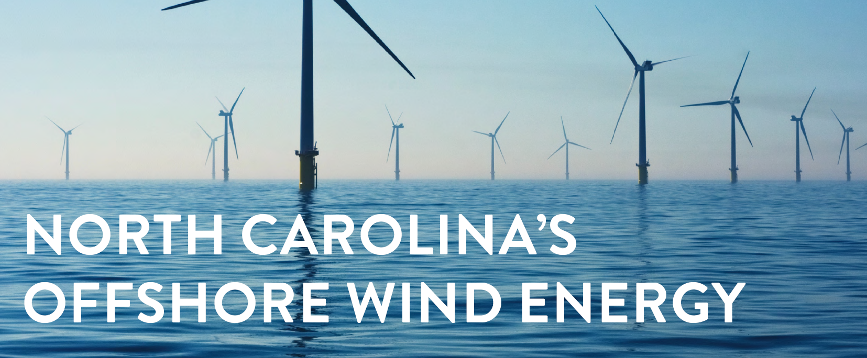
An Opportunity
OSW development provides an opportunity for hundreds of millions of dollars in economic development & thousands of new jobs in North Carolina (NC), as well a significant increase in renewable energy generation

Slide 3
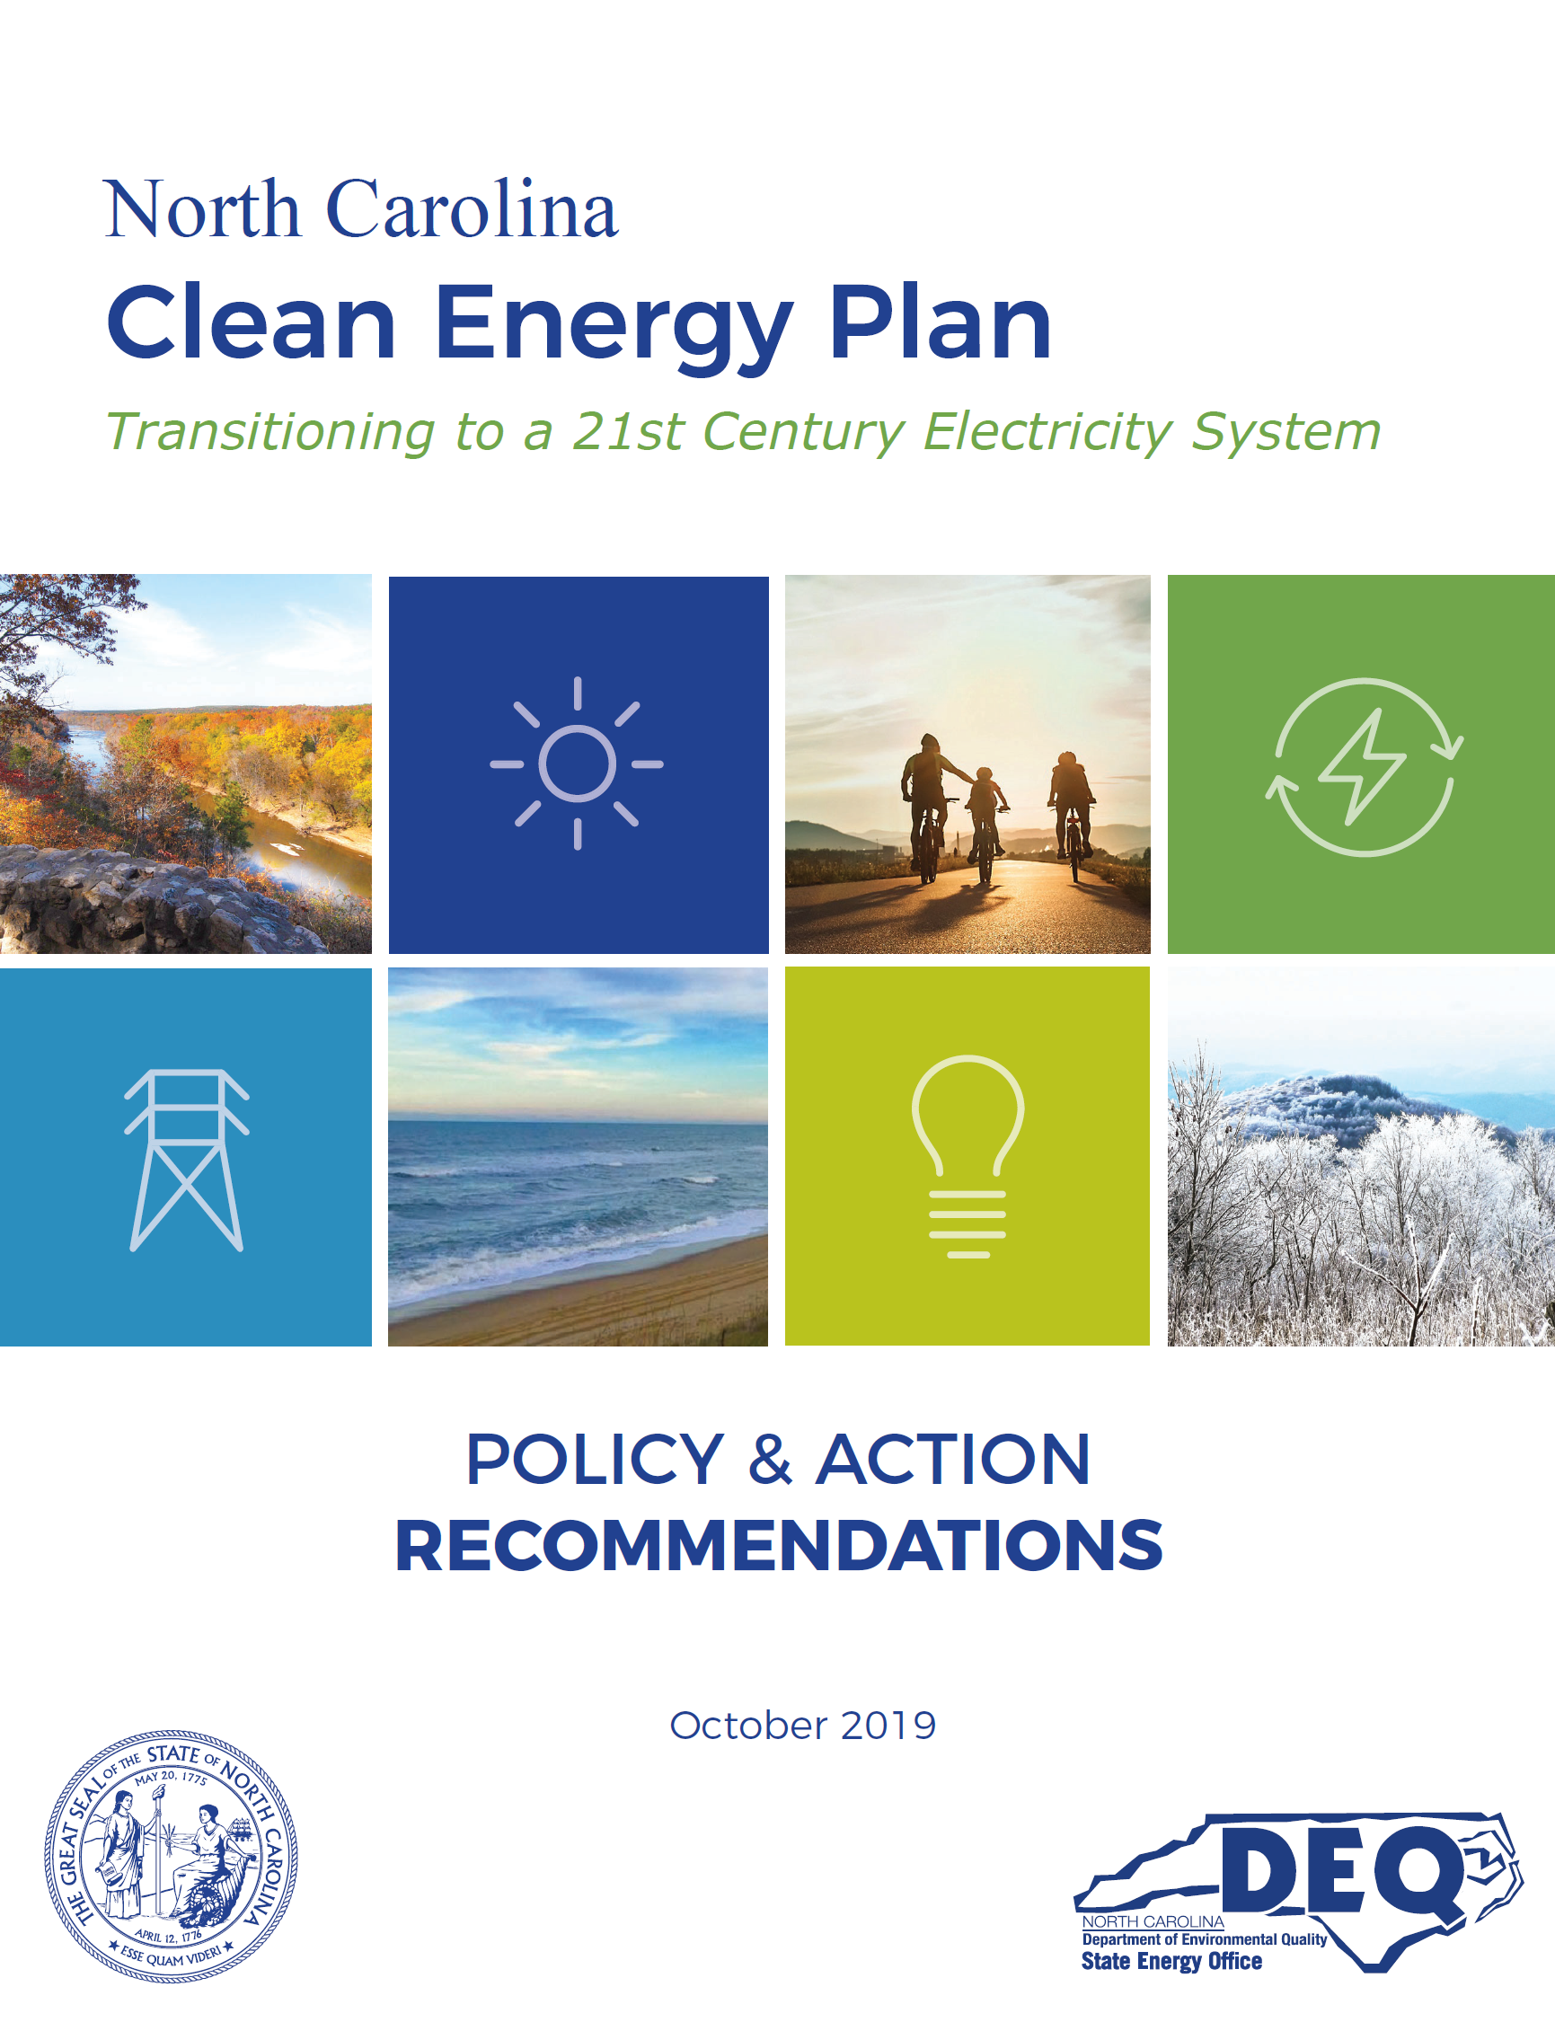
Executive Order 80
October 2018: Governor Cooper announced Executive Order 80: North Carolina’s Commitment to Address Climate Change & Transition to a Clean Energy Economy
Under EO 80, NC Department of Environmental Quality developed & released
NC Clean Energy Plan —
Includes recommendations supporting an effort with regional states to develop robust offshore wind industry & energy market

Slide 4
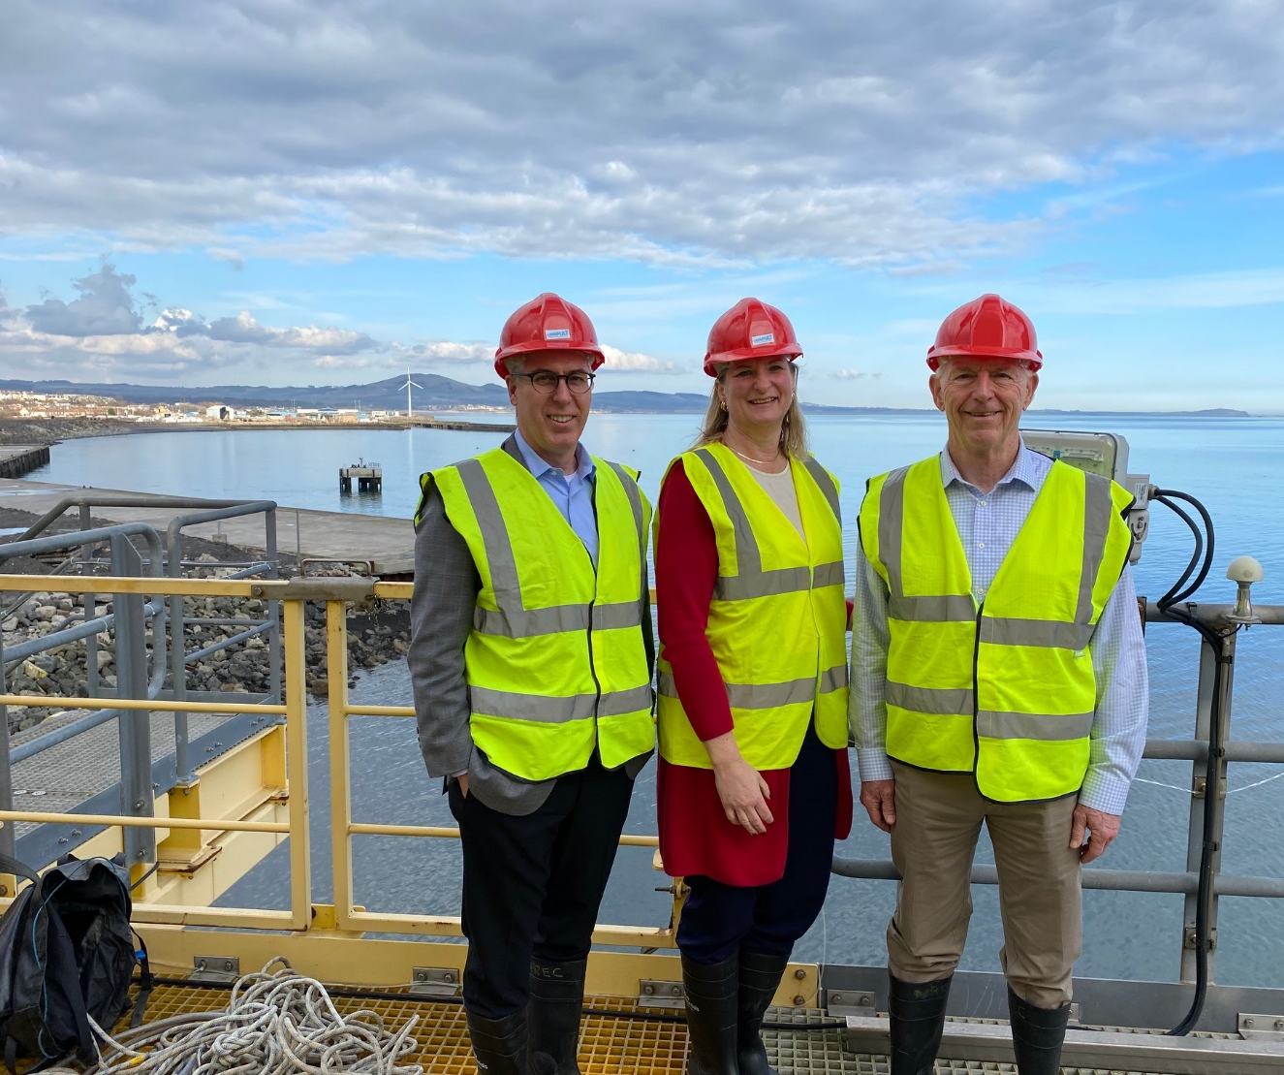
Multistate Learning
to Benefit
our Region
Fife, Scotland
March 5, 2020
Focus on floating offshore wind
North Carolina
North Carolina
Virginia

Slide 5
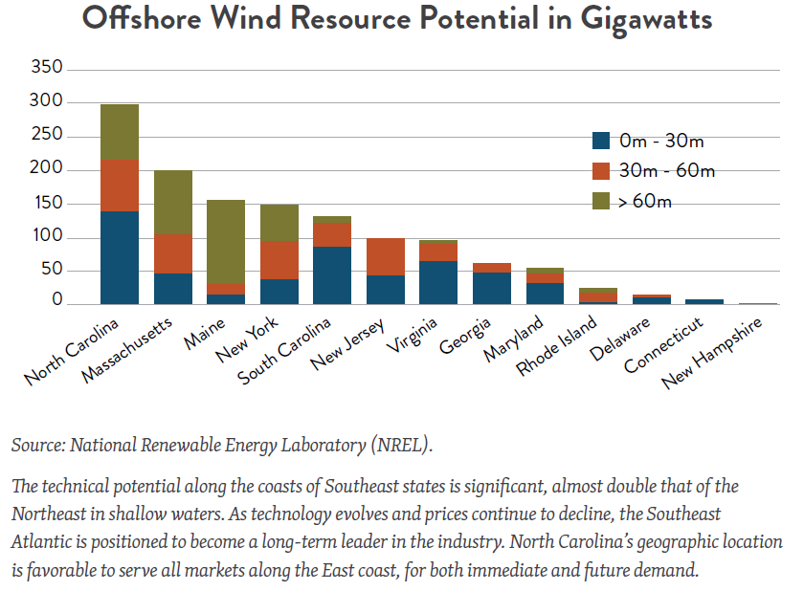
Offshore Wind Potential (Gigawatts)
Water Depth

Slide 8
NC State Leadership, Coordination & Public Representatives
Governor’s Office
Overall Leadership & Coordination
Jeremy Tarr, Senior Advisor for Climate Change Policy
Dept. of Environmental Quality
Policy Analysis, Engagement with Energy Providers & Federal Agencies
Jennifer Mundt, Senior Policy Advisor
Dept. of Commerce
Supply Chain, Infrastructure, & Economic Impacts Analysis, Engagement with Public & Communities
John Hardin, Executive Director, OSTI

Slide 9
NC OSW Supply Chain & Infrastructure Assessments
Launched August 2020
Determine how NC can successfully position itself to compete in OSW
Understand nature of existing NC businesses & orgs that can support OSW industry
Signal to OSW developers and OEMs NC’s commitment to this significant, growing industry
Identify strengths, gaps & opportunities NC can pursue to maximize the potential of OSW

Slide 10
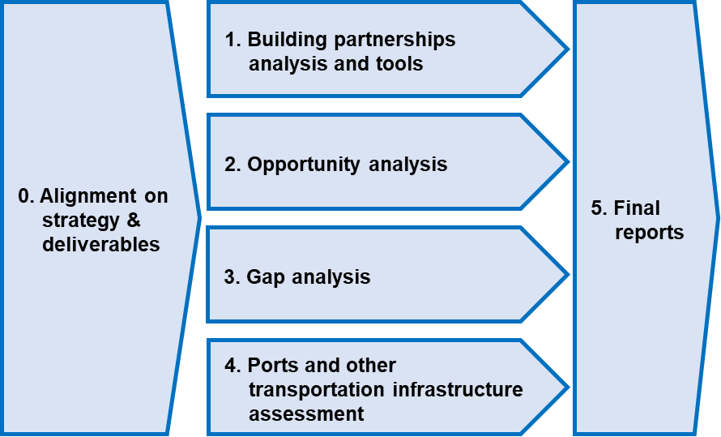
NC OSW Supply Chain & Infrastructure Assessments
Project Outline
Port of Morehead City, NC
Reports and recommendations scheduled for end of December 2020

Slide 11
Transmission
NC OSW assessment will map electricity transmission lines and locations of offshore wind farms
NC Transmission Planning Collaborative—a joint planning effort between Duke Energy, ElectriCities, & NC Electric Membership Corporation—conducted OSW integration study in 2012
Southeastern Wind Coalition recently made request to update study
(which is underway now)
Asked to identify:
3 least-cost interconnection points along the coast
What those substations' existing capability is for added generation with minimal upgrades
What "break points" would be in investment going up to 5,000 MW per interconnection point, totaling 15,000 MW
Should be completed & published by early 2021

