Slide 1
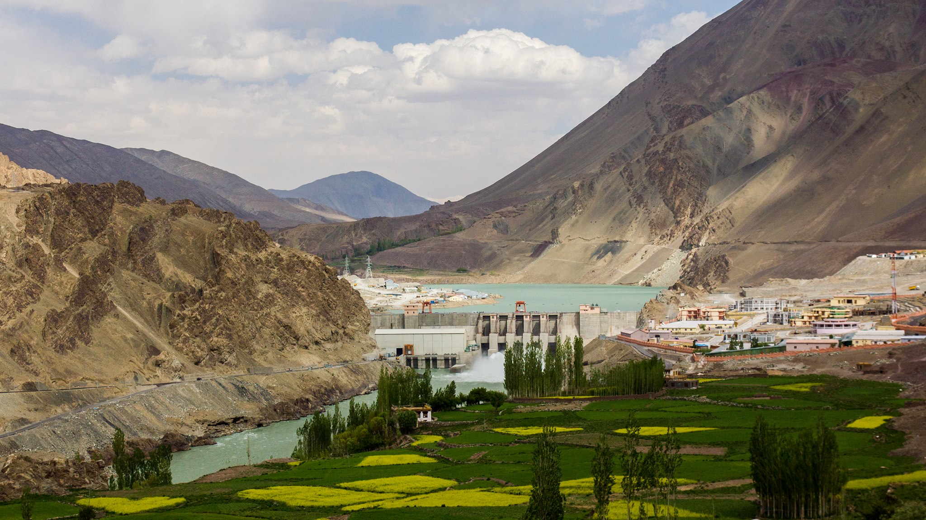
HYDROPOWER DEVELOPMENT IN INDIA
BARRIERS AND WAY FORWARD
Y K CHAUBEY
DIRECTOR (TECHNICAL), NHPC Limited

Slide 2
HYDROPOWER IN INDIA
India is blessed with vast hydropower potential. CEA Assessment of hydro potential [> 25MW capacity] is :
Total Estimated Hydropower potential 148701 MW
Installed Hydro Power Capacity 45699 MW
Balance capacity for Development 103002 MW
Hydro-Power installed capacity share : 12.3% [was 45% in 1970]
Too little required for efficient grid operation :

Slide 3
INSTALLED CAPACITY- SECTOR WISE (HYDRO)
(NHPC’s 6971.2 MW is
45.4% of 15346 MW)
PRIVATE
SECTOR
CENTRAL SECTOR
STATE SECTOR
HYDRO POTENTIAL : 1,48,701 MW
DEVELOPED (UPTO JULY-20) : 45699 MW

Slide 4
HYDROPOWER CAPACITY STATUS IN TOP FIVE STATES
ALL HIMALAYAN STATES
(AS ON 30.6.2018)
Region/ State | Identified Capacity (MW) | Installed capacity (under operation) | Capacity under construction (MW) | Capacity yet to be taken up (MW)
H P | 18540 | 9755 | 1885 | 6900
J&K | 13543 | 3449 | 1935.5 | 8158.5
U K | 17998 | 3756.4 | 1490 | 12751.6
S K | 4248 | 2169 | 1133 | 946
Ar. P | 50064 | 515 | 2744 | 46805
Total | 104393 | 16077 | 11362 | 76954
46805
SOURCE : CEA

Slide 5
Advantages of Hydropower
SUSTAINABILITY
Clean source of energy- Least emissions
Irrigation and flood control
RELIABILITY
Reliable grid support- inc. black start
Support for variable generation of renewable energy sources
AFFORDABILITY
AVAILABILITY
Instant start- stop capability
Meeting Peaking power demands
Low operating cost – virtually zero fuel cost
Long economic life
Abundant Potential
Development of fisheries and tourism

Slide 6
ABOUT NHpc LTD.
PROJECTS COMPLETED
24 NOS. (7071 MW)
INCL. JV PROJECT, WIND & SOLAR POWER
AUTHORISED CAPITAL
RS. 15,000 CRORE
PAID-UP CAPITAL
RS. 10,045 CRORE APPROX.
PROJECTS AWAITING CLEARANCES
14 NOS. (8326 MW)
INCL. JV PROJECTS
PROJECTS UNDER CONSTRUCTION
5 NOS. (4924 MW)
INCL. JV PROJECTS

Slide 7
Nhpc’s experience in Hydro
POWER STATIONS UNDER OPERATION
HP
5 NOS.
1771MW
SK
2 NOS.
570 MW
UK
2 NOS.
400 MW
J&K
8 NOS.
2339MW
WB
2 NOS.
292 MW
MANIPUR
1 NOS.
105 MW
77.7 % OF NHPC’S (INCLUDING JV) INSTALLED CAPACITY IS LOCATED IN HIMALAYAN REGION

Slide 8
Nhpc’s experience in Hydro
PROJECTS UNDER CONSTRUCTION
HP
1 NOS.
800 MW
AP
1 NOS.
2000 MW
J&K
2 NOS.
1624 MW*
SIKKIM
1 NOS.
500 MW
* 1000 MW PROJECT OWNED AND BEING EXECUTED BY CVVPL
(JV OF JKPDC, NHPC & PTC).
100 % OF NHPC’S (INCLUDING JV) PROJECTS UNDER CONSTRUCTION ARE LOCATED IN HIMALAYAN STATES

Slide 9
CHALLENGES ARE PART OF THE development of Hydropower schemes.
JOINT EFFORT FROM ALL STAKE HOLDERS ARE need OF HOUR
PEOPLE
DEVELOPER.
GOVT.
CONTRACTORS

Slide 10
Challenges In Hydro Project Development
Contractual Disputes
Law & Order
Natural Disasters
Remote Sites
Geological Uncertainties
Financial Aspects
Limited Expert Contractors
Seismological
Issues
Environmental Issues
Delayed Land Acquisition
R & R
Clearances

Slide 11
CHALLeNGEs RELATED TO Techno-commercial issues
UNIQUE DESIGNS
GEOLOGICAL UNCERTAINTIES – LIMITATION OF INVESTIGATIONS
NATURAL CALAMITIES
REMOTENESS – LACK OF INFRA-STRUCTURE
DEARTH OF COMPETENT CONTRACTING AGENCIES
SHORTAGE OF TRAINED MANPOWER

Slide 12
GEOLOGICAL CHALLENGES
HIMALAYAS ARE ONE OF THE MOST SEISMICALLY ACTIVE REGION RESULTING IN DEVELOPMENT OF MAJOR THRUST LIKE MCT, MBT, HFT ETC. AND MAKING ROCK MASS FRAGILE AND WEAK.
NATURAL SURFACE IN HIMALAYAN REGION ARE SUSCEPTIBLE TO EROSION AND HENCE HIMALAYAN RIVERS CARRY LOT OF SEDIMENTS. SHIFTING COURSES OF RIVER AND BURIED CHANNELS POSE SERIOUS CHALLENGE.
DUE TO NON-UNIFORMITY IN GEOLOGICAL SET-UP, AT TIMES, UN-EXPECTED GEOLOGICAL CONDITIONS ARE ENCOUNTERED DURING CONSTRUCTION STAGE,, LEADING TO TIME AND COST OVER-RUN.

Slide 13
REMOTENESS OF PROJECT / LACK OF INFRA-STRUCTURE
HYDRO-PROJECTS ARE LOCATED IN ROMOTE AREA AND HILLY AREAS. PROJECT SITES ARE IN-ACCESSIBLE DUE TO NON-AVAILABILTY OF ADEQUATE RAIL, ROAD, AND BRIDGES.
THERE IS ABSENCE OF TRANSMISSION LINES FOR CONSTRUCTION POWER AND EVACUATION.
REMOTENESS OF PROJECT AND LACK OF INFRA-STRUCTURES ADVERSELY AFFECT THE VIABILITY OF THE PROJECT , DIRECTLY AND / OR IN-DIRECTLY.

Slide 14
CHALLeNGES RELATED TO ENVIRONMENTAL ISSUES
EIA/EMP STUDIES – CARRYING CAPACITY STUDY – CUMMULATIVE
ASSESSMENT STUDIES
FOREST AND WILDLIFE CLEARANCE
ENVIRONMENT CLEARANCE
REHABILITATION AND RESETTLEMENT
E- FLOWS
LONGITUDINAL CONNECTIVITY

Slide 15
CHALLENGE OF MULTIPLE PUBLIC HEARINGS FOR ENVIRONMENTAL CLEARANCE
UNDER NEW RFCTLARR ACT, 2013, SOCIAL IMPACT ASSESSMENT IS MANDATORY FOR LAND ACQUISITION PROCEEDINGS. SIA INVOLVES PUBLIC HEARING WITH MULTIPLE STAKE HOLDERS.
PUBLIC HEARING IS ALSO MANDATORY AS PART OF ENVIRONMENTAL CLEARANCE PROCESS.
GRAM SABHA MEETINGS ARE ALSO CONDUCTED UNDER FOREST RIGHT ACT, 2006.
DUPLICACY OF PROCEDURES CONSUMES TIME AND RESOURCES.

Slide 16
CHALLeNGES RELATED TO Administrative issues
GOVERNMENT CLEARANCES
LAND ACQUISITION
LAW AND ORDER ASPECTS
UPFRONT CHARGES
ADDITIONAL DEMANDS BY THE STATES
INTER-STATE ASPECTS
INCREASED PUBLIC AND NGOS INTERFERENCE

Slide 17
CHALLENGES WITH GOVERNMENT (CENTRAL & STATE)
DEVELOPING POLICY FRAME WORK FOR BENEFIT SHARING WITH LOWER RIPARIAN STATES
DEFINING THE TYPE OF PROJECTS,
DEFINING THE EXTENT OF AREA INSIDE UPPER RIPARIAN STATES WHERE IF PROJECTS ARE LOCATED, ITS BENEFITS IS TO BE SHARED WITH LOWER RIPARIAN STATES.
TYPE AND QUANTUM OF BENEFIT (SUCH AS DOWNSTREAM PROTECTION WORKS, FREE POWER, ADDITIONAL POWER ETC.) TO BE SHARED ETC.
REVIEW OF POLICY FRAME WORK FOR DISBURSING OF LOCAL AREA DEVELOPMENT FUND
ENSURING THAT PROJECTS DO NOT GET STUCK MIDWAY ONCE , ALL STATUTORY APPROVALS HAVE BEEN OBTAINED INCLUDING “NO-OBJECTION CERTIFICATE” FROM THE CONCERNED STATE AND “PUBLIC HEARING”, AND ISSUES TECHNICAL, SOCIAL OR WELFARE MEASURES RELATED TO LOCALS SHOULD NOT BECOME THE ROAD BLOCKS FOR THE ONGOING HYDRO-PROJECT.

Slide 18
CHALLeNGES RELATED TO FINANCIAL ISSUES
CAPITAL INTENSIVE - LONG LOCK IN PERIOD
ADMINISTERED TARIFF REGIME

Slide 19
WAY FORWARD a national perspective
SUBSTANTIVE PLANNING
ACCEPTABILITY OF THE PROJECT
PARALLEL PROCESSING
FAST TRACK CONSTRUCTION
DISPUTE REDRESSAL

Slide 20
WAY FORWARD Substantive planning
A SHELF OF BANKABLE DPRS BE CREATED
[ON THE LINES OF PFRS PREPARED UNDER PRIME MINISTER’S 50,000 MW INITIATIVE]
STATE OF THE ART INVESTIGATIONS
[THOROUGH INVESTIGATIONS USING ADVANCED TECHNIQUE FOR SUB-SURFACE INVESTIGATION]
COST OF ENABLING INFRA-STRUCTURE
[DEVELOPING THE ENABLING INFRA-STRUCTURE BEFORE THE START OF THE PROJECT AND SHARING THE COST]

Slide 21
WAY FORWARD Substantive planning
LAND ACQUISITION- MULTIPLE PUBLIC HEARINGS
[GOVERNMENTS TO TAKE NECESSARY STEPS FOR STREAMLINING THE PROCEDURES UNDER THE NEW ACT]
E - FLOW
[A RATIONAL DETERMINATION OF E-FLOW IS REQUIRED AND NECESSARY ADJUSTMENT IN TARIFF]

Slide 22
WAY FORWARD Acceptability of projects
DEVELOPMENTAL PIE MUST BE SHARED
[ERST WHILE PROJECTS LIKE BHAKRA HAD BENEFITTED U/S AS WELL AS D/S POPULACE e.g. IRRIGATION, IN EQUAL MEASURE AND WERE WELL ACCEPTED BY ALL]
DOWNSTREAM RIPARIAN RIGHTS
[ASSAM HAS A UNIQUE GEOGRAPHICAL LOCATION WHEREBY RATHER THAN IRRIGATION THE FLOOD MODERATION & PROTECTION DURING FLOODS IS MORE RELEVANT]

Slide 23
WAY FORWARD Parallel processing
TENDERING PROCESS
[PROCESS OF MAIN WORK TENDERING TO BE STARTED
AFTER TEC ALONG WITH PROCESSING FOR PIB/CCEA]
EARLY START OF INFRA-STRUCTURAL WORK
[POSSIBILITY OF UNDERTAKING SOME OF THE INFRA-
STRUCTURE WORKS BEFORE MAJOR WORKS BEGIN]
EARLY MOBILISATION OF CRITICAL EQUIPMENTS
[PROCURING CRITICAL EQUIPMENT BEFORE AWARD
OF CONTRACTS TO CUT LEAD TIME]

Slide 24
WAY FORWARD Fast track construction
TIME SAVING TECHNOLOGIES AND BEST PRACTICES
STATE OF THE ART TECHNOLOGY AND EXPERT’S HELP
DEPLOYMENT OF RIGHT KIND OF CONSTRUCTION EQUIPMENTS BY CONTRACTOR

Slide 25
WAY FORWARD Dispute redressal
VALUE ENGINEERING AND VALUE ANALYSIS
RESOLVING CONTRACTUAL DISPUTE QUICKLY
INSTITUTIONALISED & UN-AMBIGUOUS REDRESSAL
MECHANISM
RISK SHARING MECHANISM FOR GEOLOGICAL
UN-CERTAINTIES, FLOODS & OTHER NATURAL CALAMITIES
CLARITY IN INSURANCE RELATED DISPUTES

Slide 26
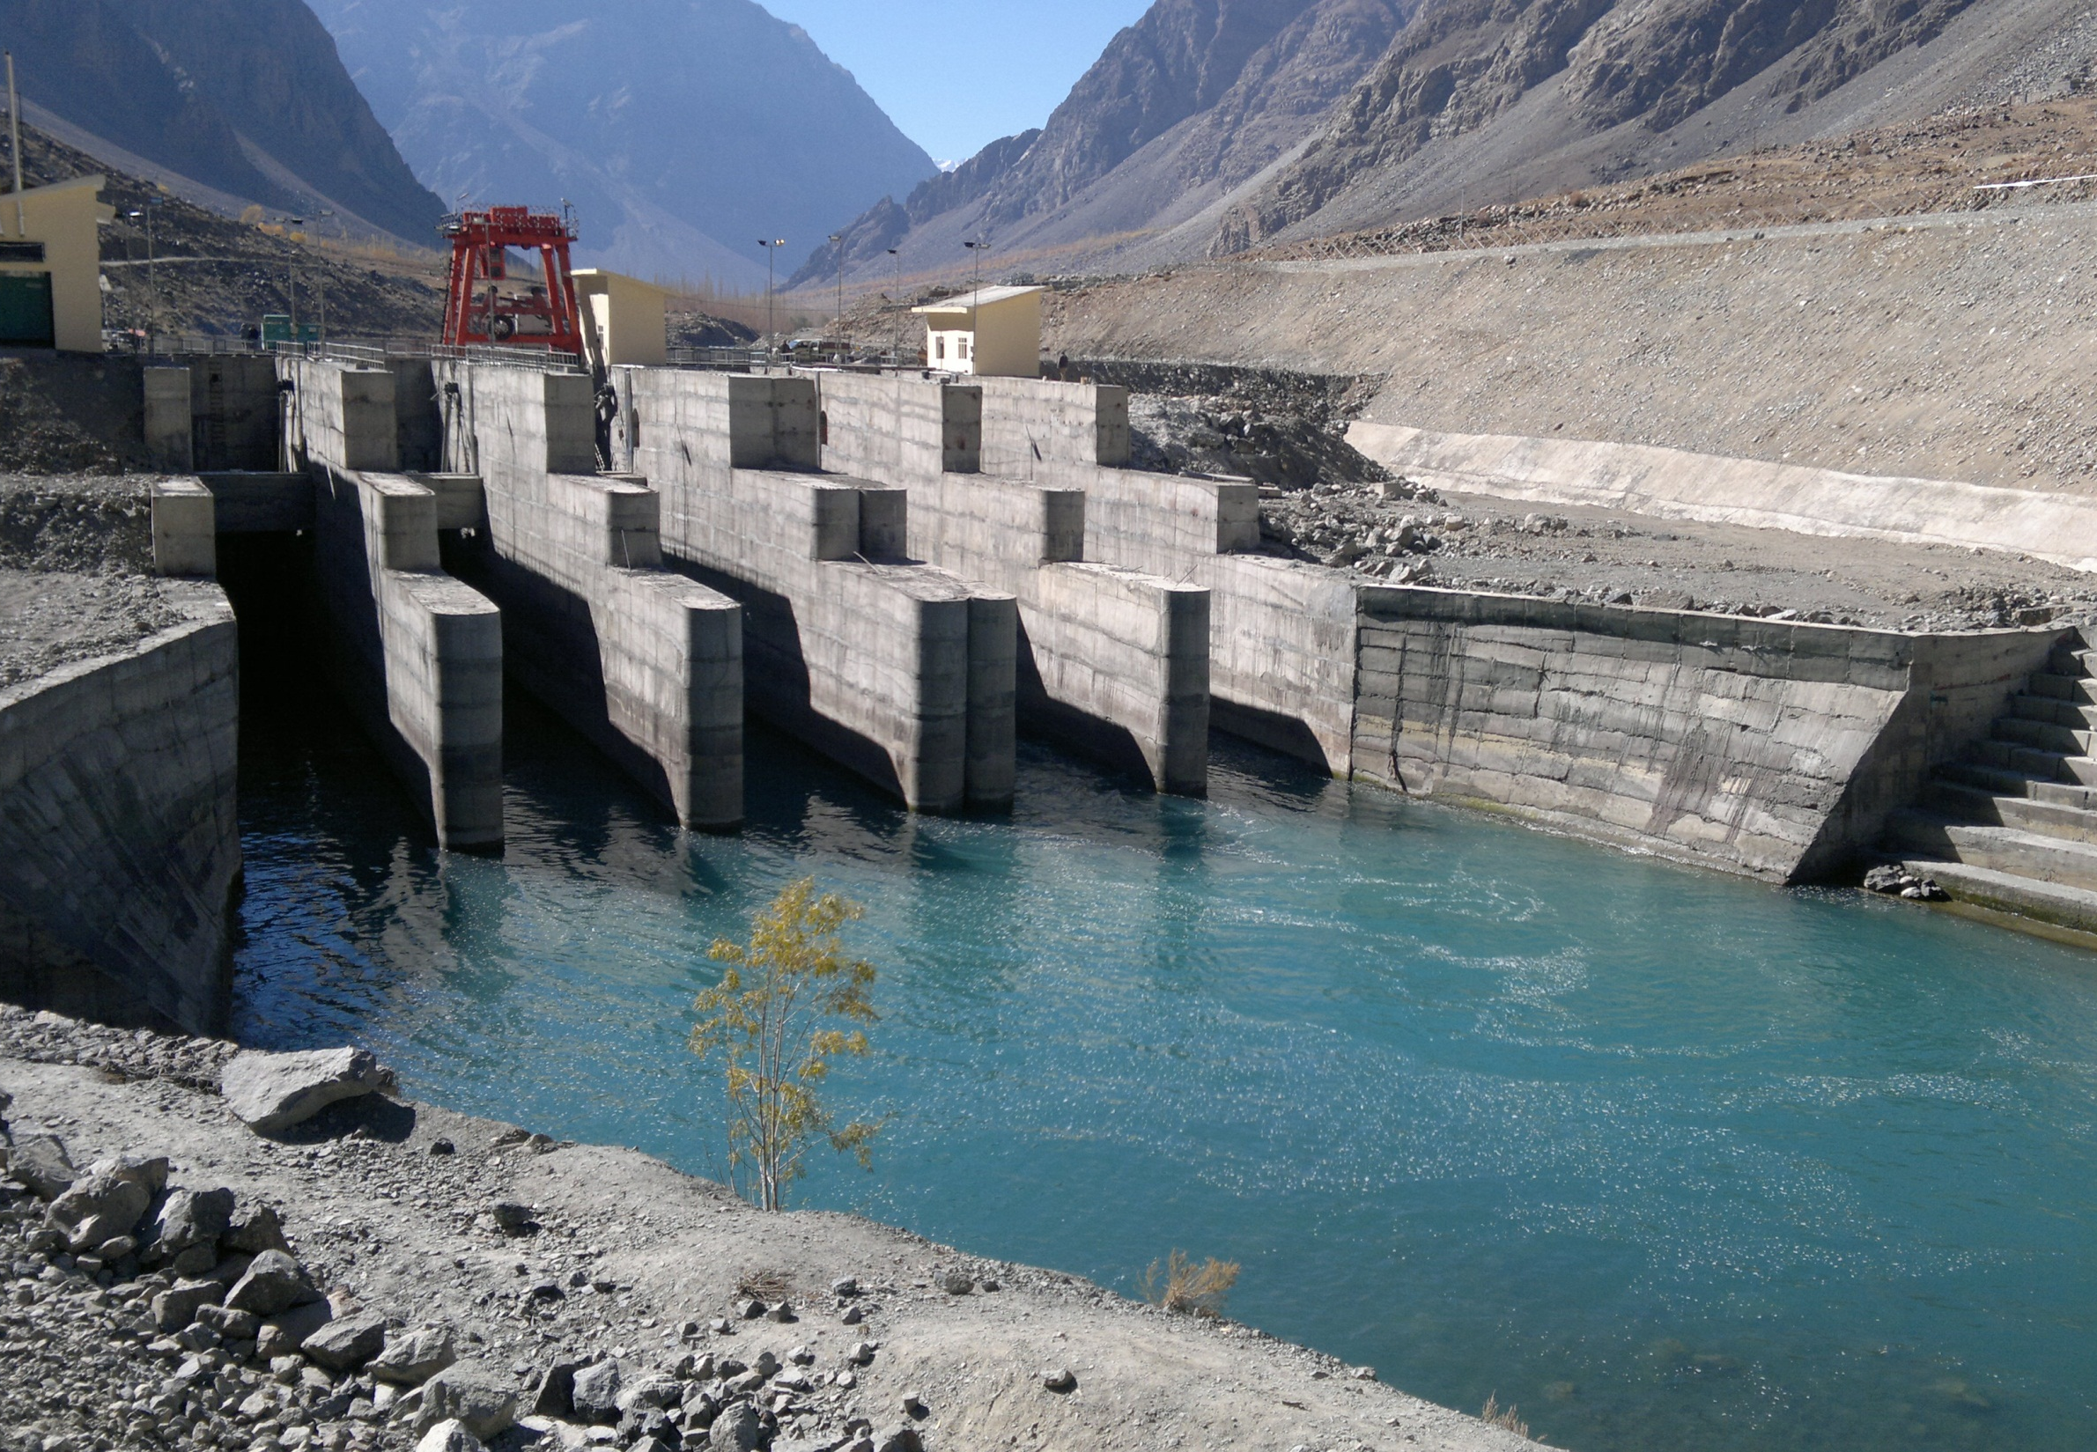
THANK YOU

